Slide 1
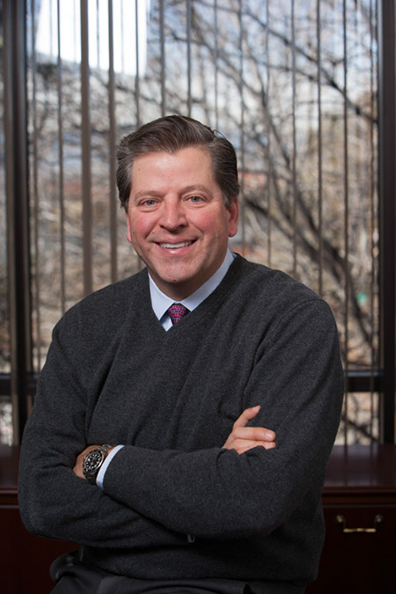
AgriBusiness Club and WUREC present
A Conversation with
Paul Pittman
CEO and Executive Chairman, Farmland Partners
THURSDAY, December 3rd, 6:00pm EST
Location: https://upenn.zoom.us/j/93051369885
Meeting ID: 930 5136 9885
Don’t miss your chance to learn about the largest farmland real estate investment trust (REIT) from the CEO himself!
Email us at info@agribusiness-club.com for more information or questions.

